Slide 1
Green Bliss (A Web Application)
Submitted by: Shivani M. Awatade Roll No: 21403
Project Guide: Dr. Milind Godase
MCA-II Sem-4
Sinhgad Institute Of Management, Pune

Slide 2
Introduction
“Green Bliss” is a web application introduced with an objective of providing an e-commerce platform for gardening-enthusiasts. It provides a platform for the nursery owner to sell his products like saplings, seeds, fertilizers and other gardening/horticulture equipment. It will ease the efforts for owners as well as the customer and will save their time and efforts. It also eliminate a lot of paper work and make things hassle-free.

Slide 3
Objectives & Scope
To provide an online platform for gardening enthusiasts for buying gardening products from the comfort of home.
Enables the owner to view and solve the customer’s queries/problems at one place through chat system. They can also update regarding it solutions conveniently.
By saving time for customers by eliminating the need to physically visit the nursery for buying products or resolving query.
It eliminates the need of paper work and saves time.

Slide 4
Modules
Profile Module
Product Module
Cart & Order Module
Payment Module
Ticket Module
Feedback Module

Slide 5
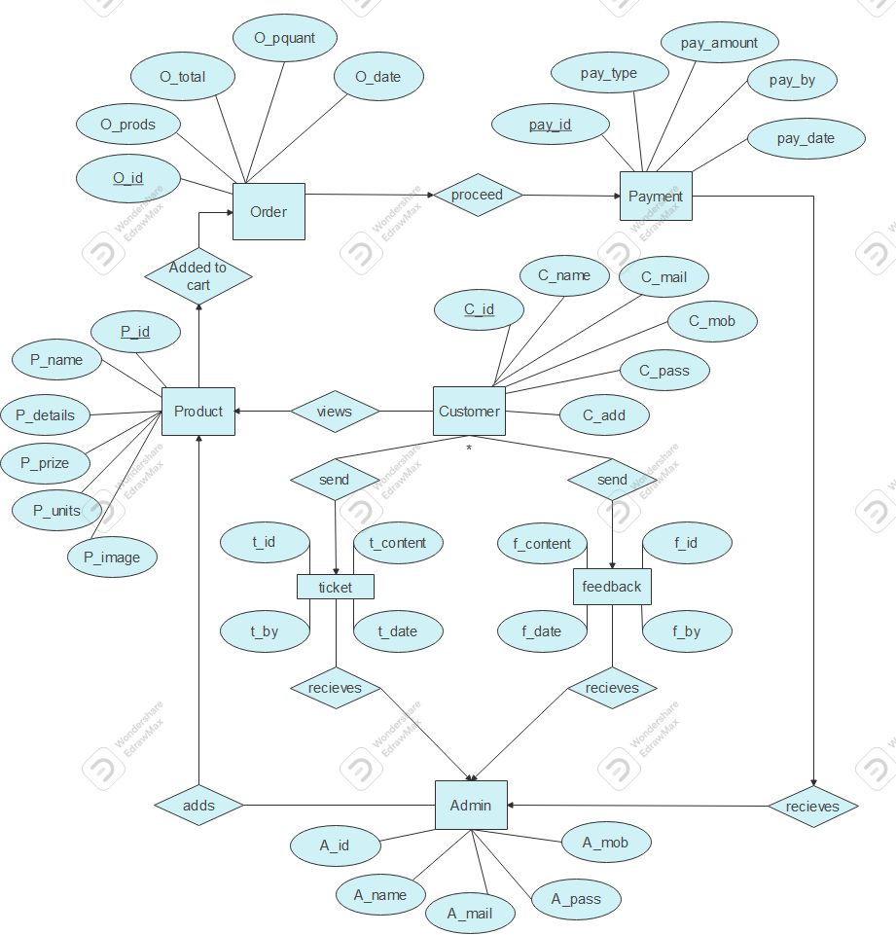
Design & Analysis
ERD Diagram

Slide 6
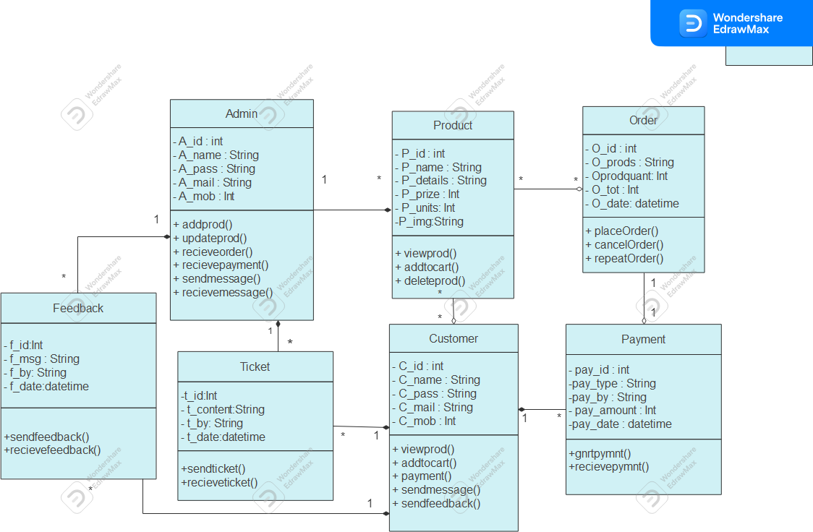
Design & Analysis
Class Diagram

Slide 7
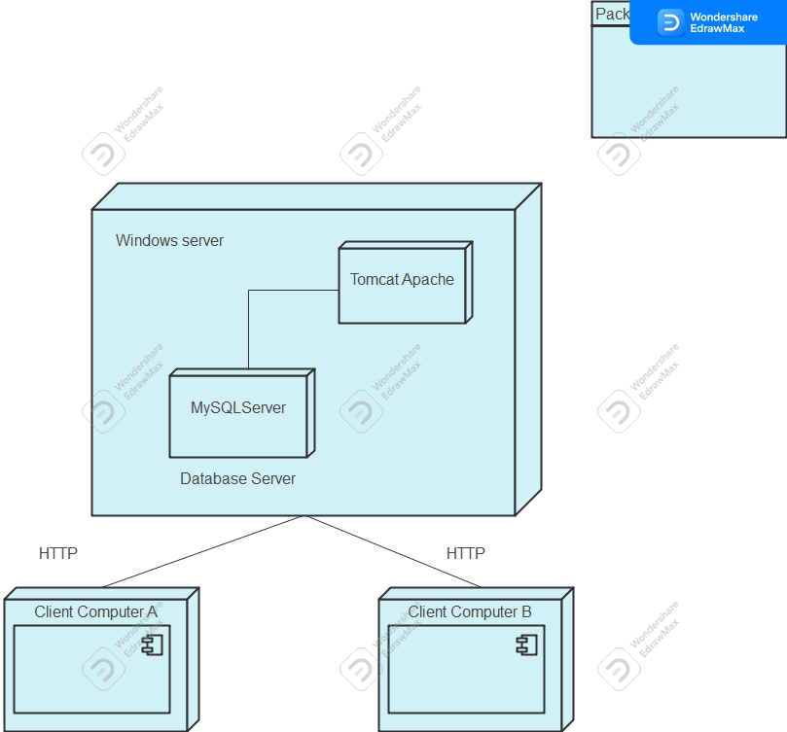
Design & Analysis
Deployment Diagram

Slide 8
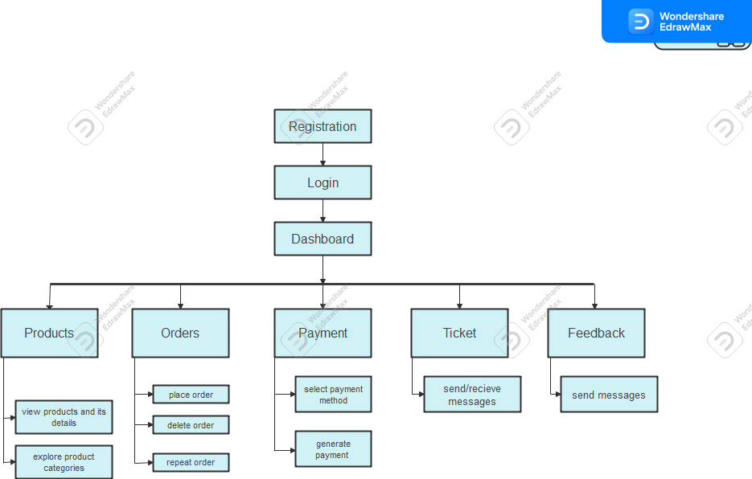
Design & Analysis
Module Hierarchy Diagram

Slide 9
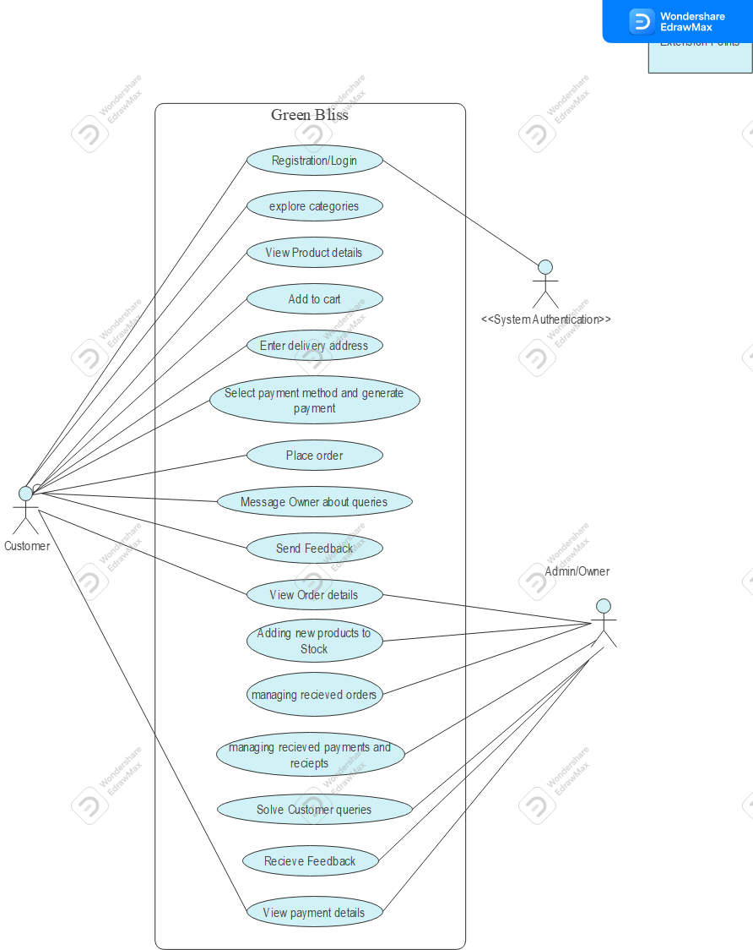
Design & Analysis
Use case Diagrams
1. System

Slide 10
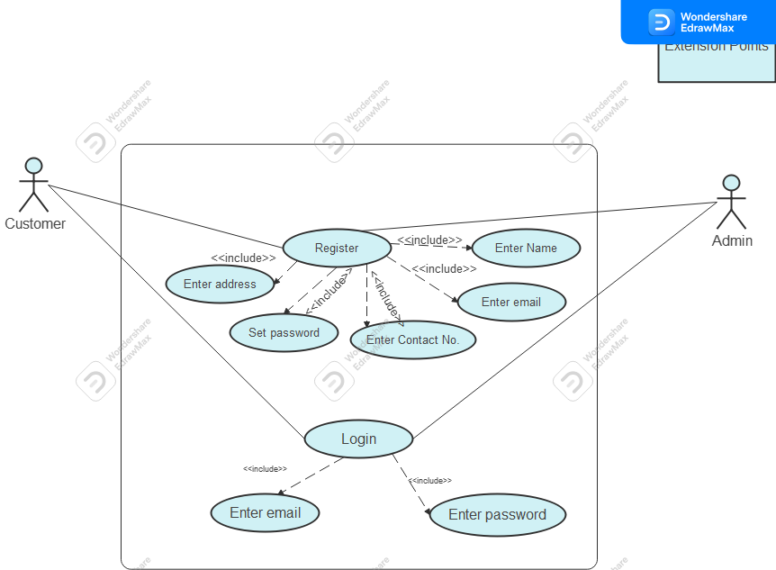
Design & Analysis
Use case Diagrams
2. Profile Module

Slide 11
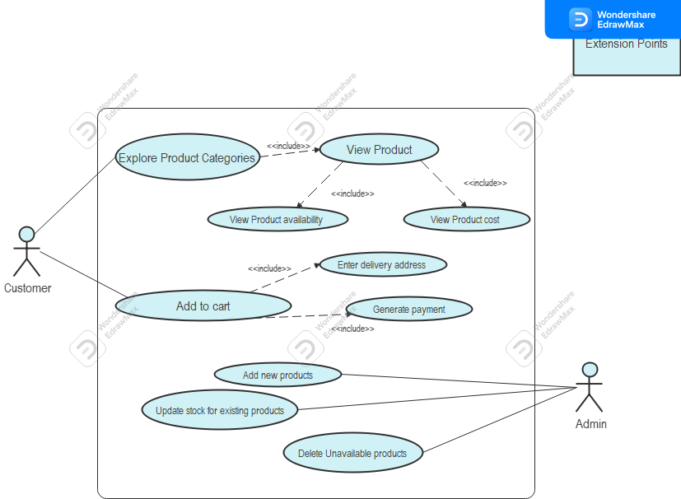
Design & Analysis
Use case Diagrams
3. Product Module

Slide 12
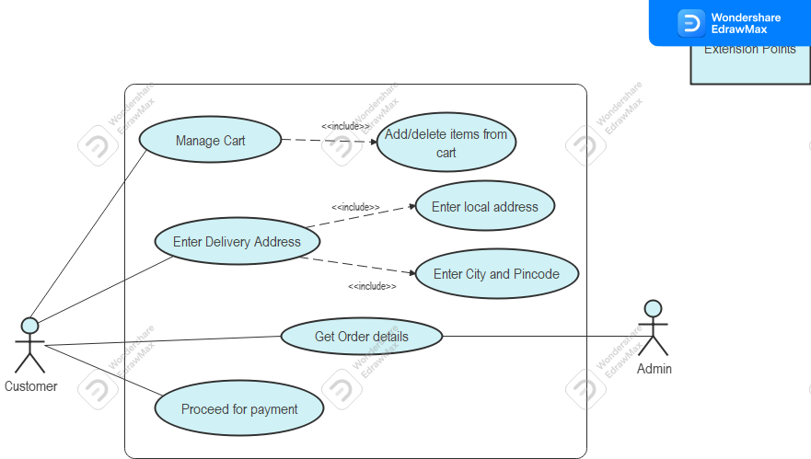
Design & Analysis
Use case Diagrams
4. Cart & Order Module

Slide 13
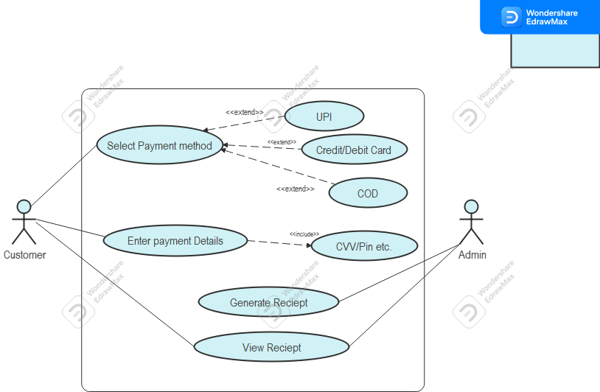
Design & Analysis
Use case Diagrams
5. Payment Module

Slide 14
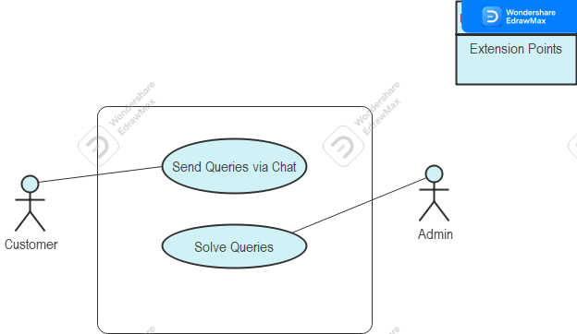
Design & Analysis
Use case Diagrams
7. Ticket Module

Slide 15

Design & Analysis
Use case Diagrams
8. Feedback Module

Slide 16
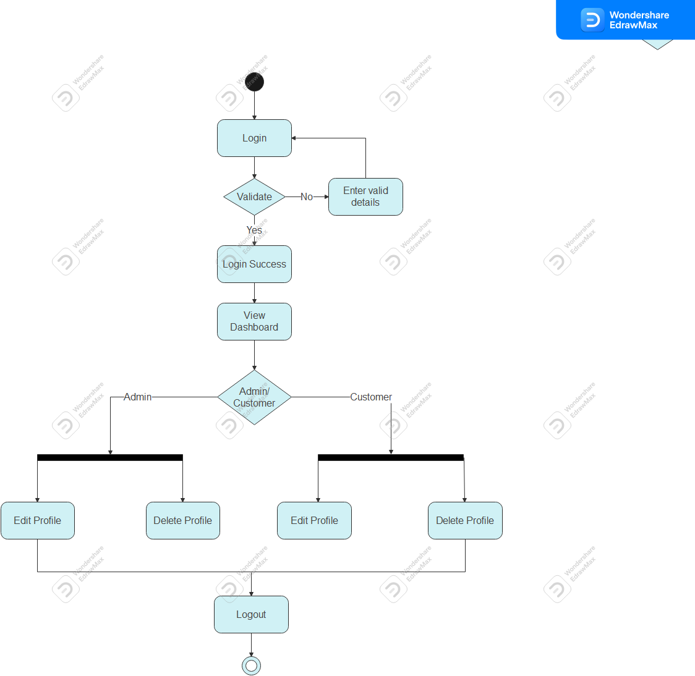
Design & Analysis
Activity Diagrams
1. Profile Module

Slide 17
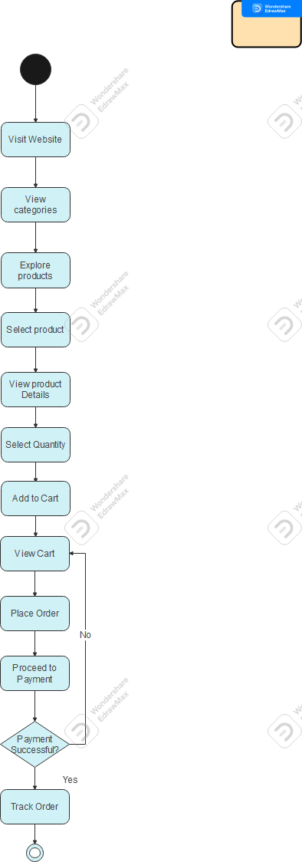
Design & Analysis
Activity Diagrams
2. Product Module

Slide 18
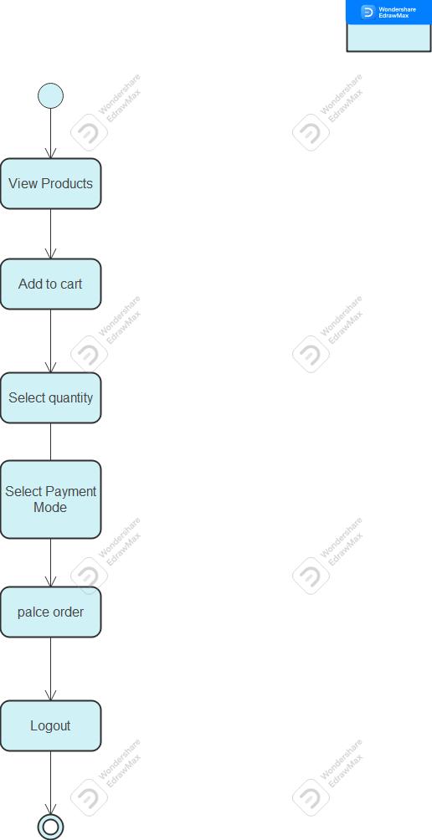
Design & Analysis
Activity Diagrams
3. Cart & Order Module

Slide 19
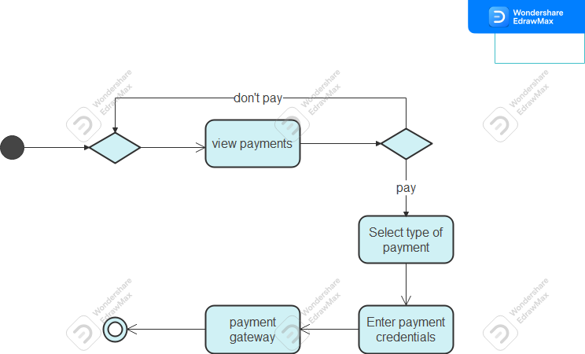
Design & Analysis
Activity Diagrams
4. Payment Module

Slide 20
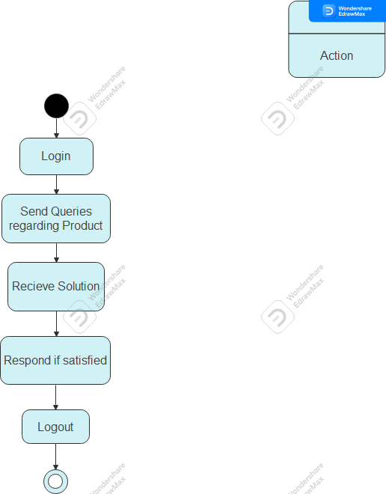
Design & Analysis
Activity Diagrams
5. Chat Module

Slide 21
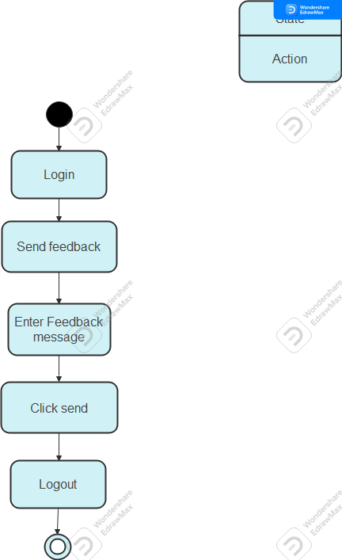
Design & Analysis
Activity Diagrams
6. Feedback Module

Slide 22
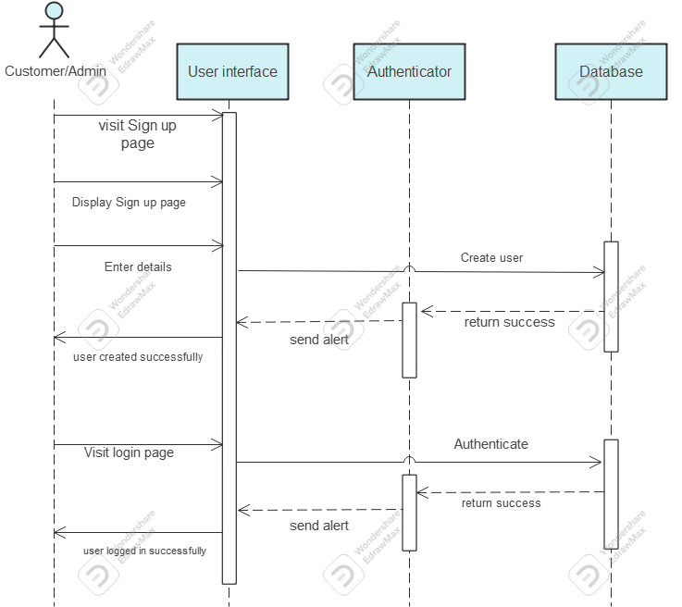
Design & Analysis
Sequence Diagrams
1. Profile Module

Slide 23
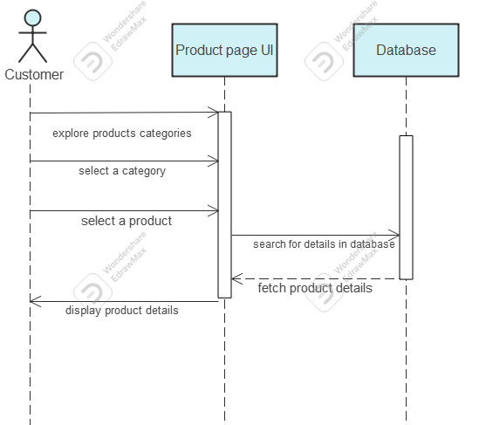
Design & Analysis
Sequence Diagrams
2. Product Module

Slide 24
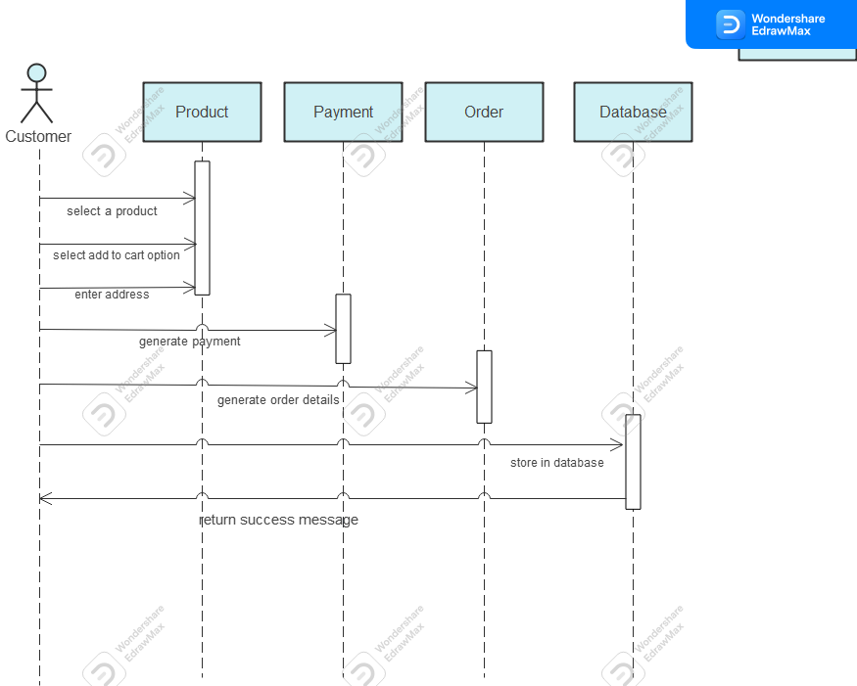
Design & Analysis
Sequence Diagrams
3. Order Module

Slide 25
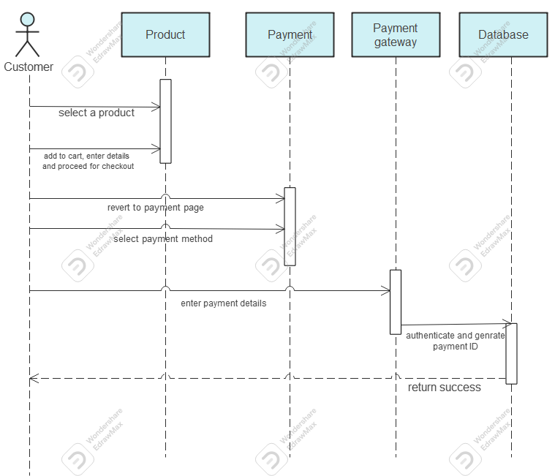
Design & Analysis
Sequence Diagrams
4. Payment Module

Slide 26
Data Specifications
Table Name: Admin
Description: Used for storing admin details and credentials.
Primary Key: a_id (Admin ID)
Fields Name | Data Type | Size | Constraint | Description
a_id | Int | 2 | Not Null, Unique | Admin Id: used as identification for different admins, and for internal tracking of updates for admin panel.
a_mail | String | 20 | Not Null | Admin Mail: used as identification for different admins, and can be used as credentials for login purpose.
a_mob | Int | 10 | Not Null | Admin Mobile: used for admin contact details.
a_name | String | 20 | Not Null | Admin Name: used for recording names of different admins and as their unique identification.
a_pass | String | 12 | Not Null | Admin password: used as personal credentials for different admins and for login purpose.

Slide 27
Data Specifications
Fields Name | Data Type | Size | Constraint | Description
c_id | Int | 5 | Not Null | Customer Id: used as identification for different customers, and for internal tracking of records for admin panel. It’ll also be used for generating order and payments uniquely for different customers.
c_add | String | 300 | Not Null | Customer Address: used for customer contact details.
c_mail | String | 20 | Not Null, Unique | Customer Mail: used as identification for different customer, and can be used as credentials for login purpose.
c_mob | Int | 10 | Not Null | Customer Mobile: used for customer contact details.
c_name | String | 20 | Not Null | Customer Name: used for recording names of different customers and as their identification.
c_pass | String | 12 | Not Null | Customer password: used as personal credentials for customers and for login purpose.
Table Name: Customer
Description: Used for storing customer details and credentials.
Primary Key: c_id ( Customer ID)

Slide 28
Data Specifications
Table Name: Feedback
Description: Used for storing feedback details generated by user.
Primary Key: f_id (Feedback ID)
Fields Name | Data Type | Size | Constraint | Description
f_id | Int | 10 | Not Null, Unique | Feedback Id: Used for uniquely identifying the feedback given by customers.
f_by | String | 20 | Not Null | Feedback by: Used for identification of the person, who has given the feedback.
f_content | String | 200 | Not Null | Feedback content: Used for storing comments the customer has given as feedback.
f_time | Datetime | 6 | Not Null | Feedback time: Used for storing the time when the customer gave the feedback.

Slide 29
Data Specifications
Fields Name | Data Type | Size | Constraint | Description
o_id | Int | 10 | Not Null, Unique | Order Id: Used for unique identification of the orders. It’ll be used for generating the receipts.
o_prods | String | 200 | Not Null | Order prods: Used for storing list of products, each order contains.
o_quant | Int | 5 | Not Null | Order quantity: Used for storing the total number of products an order contains.
o_tot | Int | 10 | Not Null | Order total: Used for storing the total amount of all the products together.
o_date | Datetime | 6 | Not Null | Order date: Used for storing the time and date on which the order was generated.
Table Name: Order
Description: Used for storing order details generated by user.
Primary Key: o_id (Order ID)

Slide 30
Data Specifications
Fields Name | Data Type | Size | Constraint | Description
p_id | Int | 5 | Not Null, Unique | Product Id: Used for uniquely identifying different products. Also used in order receipt.
p_details | String | 300 | Not Null | Product Details: Used for storing the product description.
p_img | String | 20 | Not Null | Product Image: Used for storing the product image.
p_name | String | 20 | Not Null | Product Name: Used for uniquely identifying different products. Also used in order receipt.
p_price | Int | 10 | Not Null | Product Price: Used for storing the price of product. Also used for generating total in order.
p_units | Int | 10 | Not Null | Product Units: Used for storing the product units.
Table Name: Products
Description: Used for storing Product details added by admin.
Primary Key: p_id (Product ID)

Slide 31
Data Specifications
Field Name | Data Type | Size | Constraint | Description
pay_id | Int | 5 | Not Null, Unique | Payment Id: Used for uniquely identifying different payments. Also used in order receipt.
pay_amt | Int | 10 | Not Null | Payment amount: Used for storing the amount paid.
pay_by | String | 20 | Not Null | Payment by: Used for identifying the person who has generated the payment.
pay_time | Datetime | 6 | Not Null | Payment time: Used for storing the time when the payment has been generated.
pay_type | String | 10 | Not Null | Payment type: Used for storing the way payment has been made (e.g. UPI, Card etc.)
Table Name: Payments
Description: Used for storing payment details generated by user.
Primary Key: pay_id (Payment ID)

Slide 32
Data Specifications
Field Name | Data Type | Size | Constraint | Description
t_id | 5 | Int | Not Null, Unique | Ticket Id: Used for uniquely identifying ticket generated by the customer. Also will be used while responding to the queries of customer.
t_by | 20 | String | Not Null | Ticket by: Used for storing the name of customer who has generated the ticket. Also used for responding.
t_con | 200 | String | Not Null | Ticket Content: Used for storing the queries generated by the users.
t_time | 6 | Datetime | Not Null | Ticket Time: Used for storing the time when the ticket was generated.
Table Name: Ticket
Description: Used for storing ticket details generated by user.
Primary Key: t_id (Ticket ID)

Slide 33
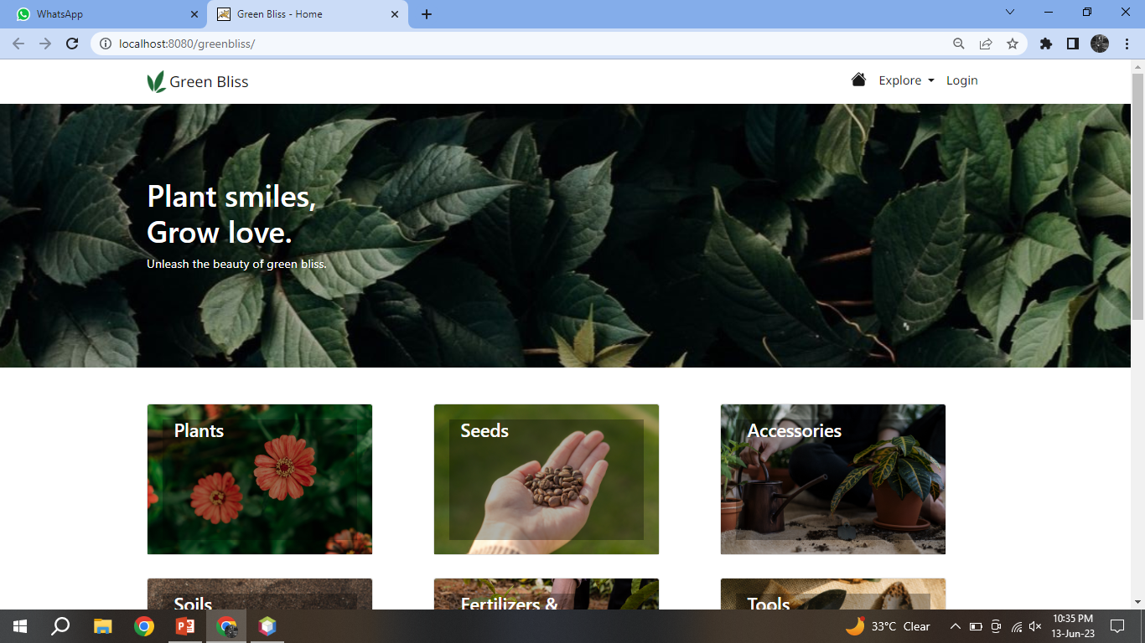
Input & output screens
Home Page

Slide 34
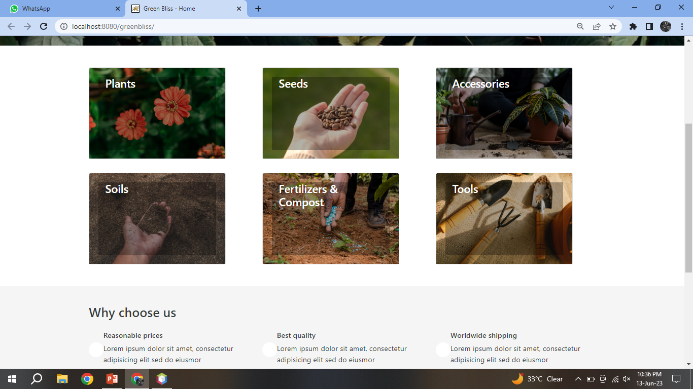
Input & output screens
Home Page

Slide 35
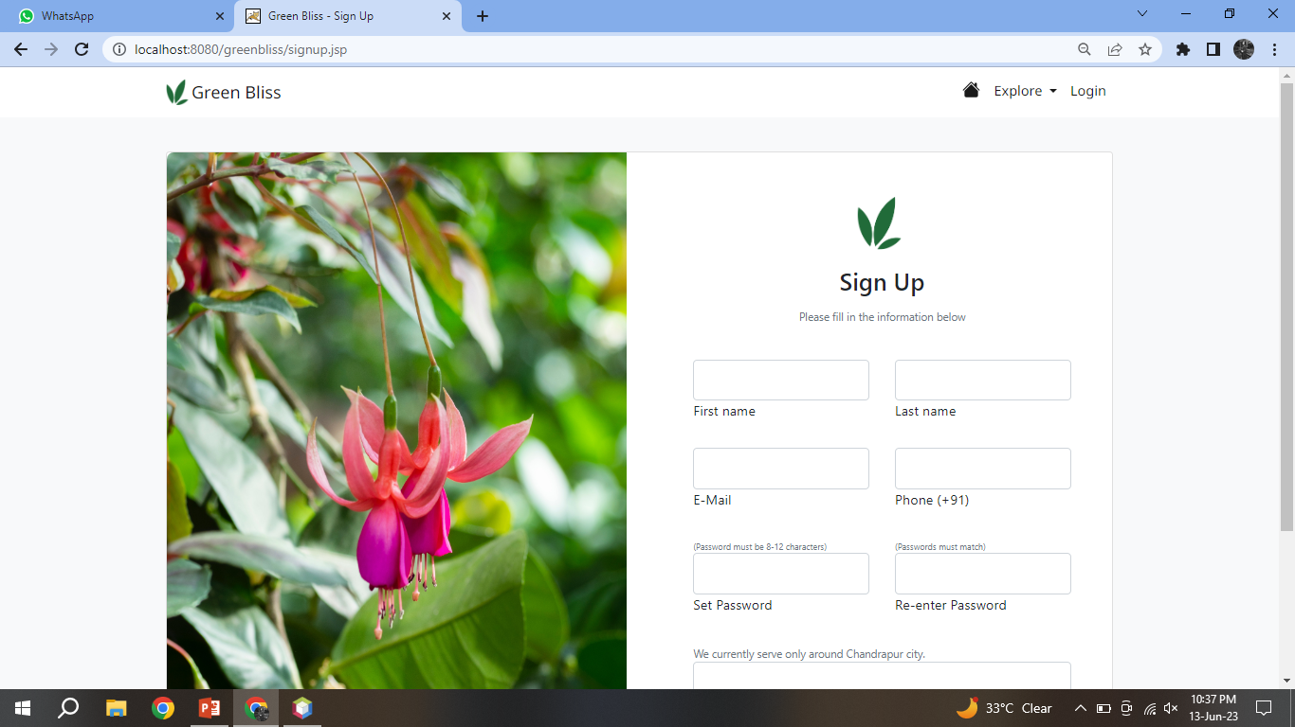
Input & output screens
Sign Up Page

Slide 36
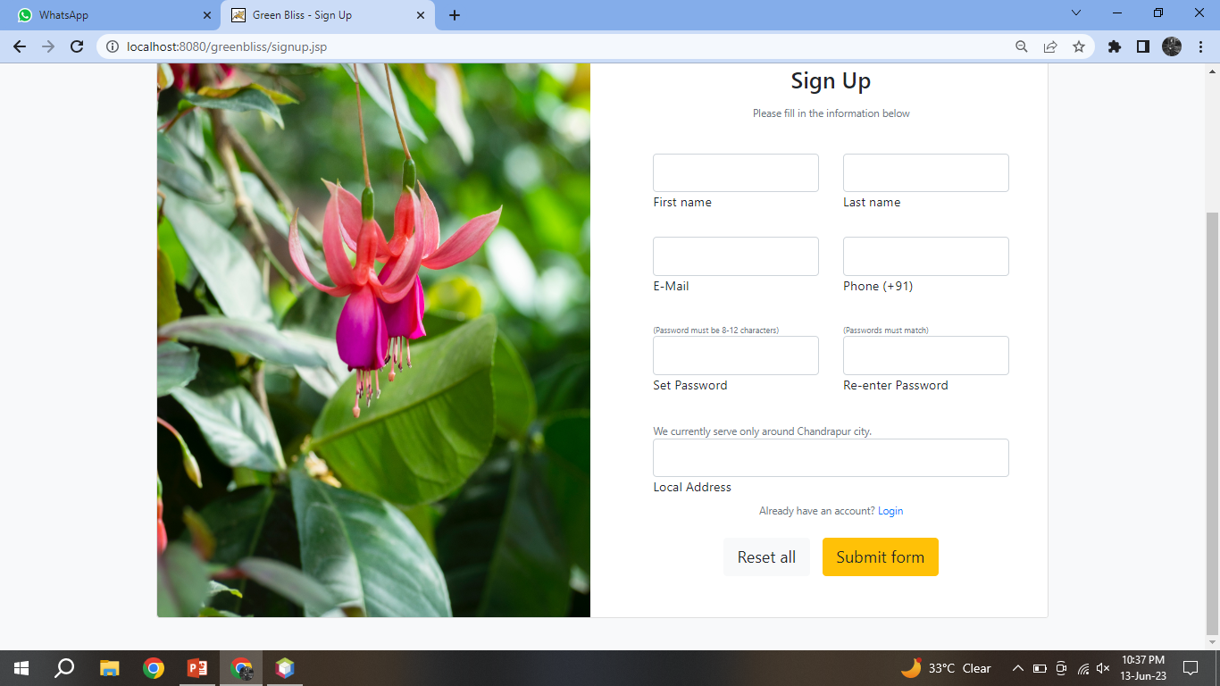
Input & output screens
Sign Up Page

Slide 37
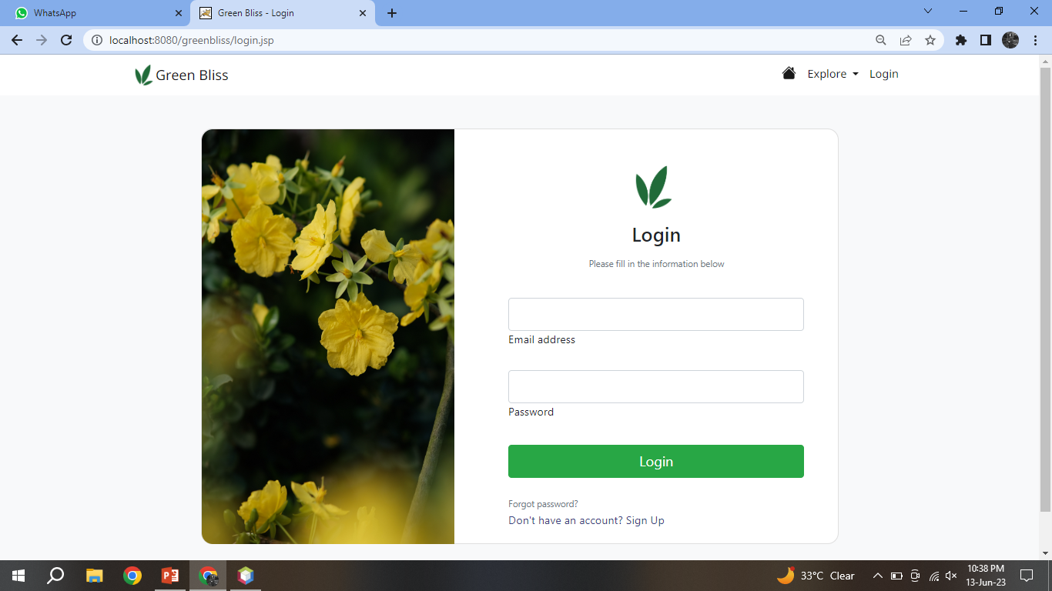
Input & output screens
Login Page

Slide 38
Thank You!

